Slide 1

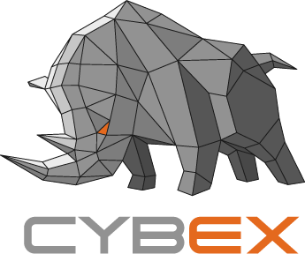
CYBEX PARTNERS PROGRAM
Decentralized Financial Infrastructure Solution
Cybex Confidential Proprietary

Slide 2

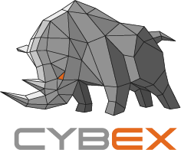
CONTENTS
Decentralized Financial Infrastructure Solution
Products and Solutions
01
02
Partners Program Overview
Benefits and Rewards
03
04
Partners with Cybex

Slide 3
01
Products and Solutions
Cybex provides business partners with the products and solutions that will accelerate their time for value and growth.

Slide 4
Products and Solutions
Decentralized Financial Infrastructure Solution
WHAT MAKES CYBEX
DIFFERENT?
DECENTRALIZED EXCHANGE
DEX is a wallet based accounts system with order book and match engine. It setup a decentralized marketplace for cryptoassets on blockchain.
REALTIME ORDER MATCHING ENGINE
ROME gets order matched in real time like centralized exchanges without sacrificing on-chain transparency. It facilitates Market Markers to provide liquidity to DEX.
05
04
JADEPOOL
Jadepool, as a hot wallet, is developed with custodian security to automatically deposit and withdrawal of multi-chain crypto currency
CYBEX GATEWAY
Gateways channel multi-chain crypto assets to the Cybex blockchain. It issues redeemable IOUs as fungible and divisible assets on the Cybex blockchain.
03
02
01
WOOKONG (Enterprise Version)
Wookong, as a cold wallet, implements hardware multi-signature capability with secret sharing cryptography algorithm.

Slide 5
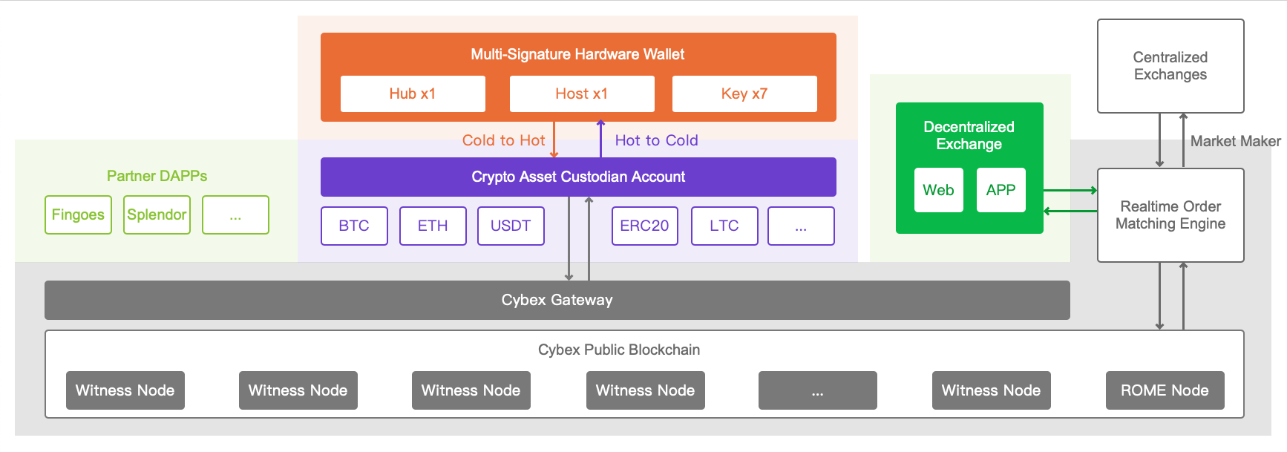
Ecosystem Architecture
Decentralized Financial Infrastructure Solution

Slide 6
02
Partners Program Overview
Round out your portfolio of products, solutions and services to enter the Cybex ecosystem of opportunity.

Slide 7
Explore the Function Units
Decentralized Financial Infrastructure Solution
WITNESS NODE
The witnesses’ job is to collect transactions, bundle them into a block, sign the block and broadcast it to the network.
DAPP DEVELOPER
Cybex provides better quality services at a fraction of the cost whether the business area is lottery, auction, ticket or many others.
CYBEX GATEWAY
Gateway takes users’ funds and converts them to their corresponding IOU assets issued by Gateway at a fee and vice versa.
REFERRAL PROGRAM
Every Cybex lifetime member can get a cut of the fees based on sub-accounts linked to ours via referral.
DECENTRALIZED EXCHANGE
DEX comes with a very particular set of advantages such as the global unified order book and the provable order matching algorithm.
BUDGET ITEMS
Network contributors can get payment for their budget items from the Cybex non-liquid reserve pool.
Notes:
Under “Referral Program,” what do you mean by child accounts? Is it an actual account for children or do you mean to say it’s a recently opened account?

Slide 8
Services for Partners
Decentralized Financial Infrastructure Solution
SOFTWARE CATALOG
Start expanding your business through distributed software solutions with Cybex’s administrator management system.
Advocacy and Support
Education and Training
ADVOCACY & SUPPORT
Have all of your questions on any aspect answered by telephone, live chat and email. Promote your client solution built on Cybex products or technologies to other business partners.
Software Catalog
EDUCATION & TRAINING
Wikis, demos, and personalized courses for the developer community will help you to reduce the education costs and will aid in the access of the full inventory of Cybex products and technologies.

Slide 9
03
Benefits and Rewards
As you advance in the partner program, the value of benefits increase to match your cooperation, portfolio, and expertise.

Slide 10
Partners Program Benefits
Decentralized Financial Infrastructure Solution
BECOME A CYBEX GATEWAY
The most straightforward method is by charging transaction fees every time someone moves value through your service. Gateway can also make money by charging users a fee every time they move one of its assets on the Cybex network and from market fees.
DEVELOP CYBEX DAPPS
For businesses, the Cybex network can be used to issue their own token and let customers trade their shares either against predefined assets, or freely against any other asset. Merchants make use of the currency-denominated assets. Similar to traditional payment solutions, they let their customers pay using stable blockchain assets.
1
2
3
4
RUN A WITNESS NODE
For each successfully constructed block, a witness node is paid in shares that are taken from the limited reserves pool at a rate that is defined by the shareholders by means of unanimous vote.
JOIN IN REFERRAL PROGRAM
The referral fees are controlled by the blockchain and are distributed like this: 20% go to the network and 80% go to the referral program; of this 80%, 30% go to the lifetime referrer and 50% go to the registrar; of this 50%, the registrar sets the percentage that will go to the affiliate referrer.

Slide 11
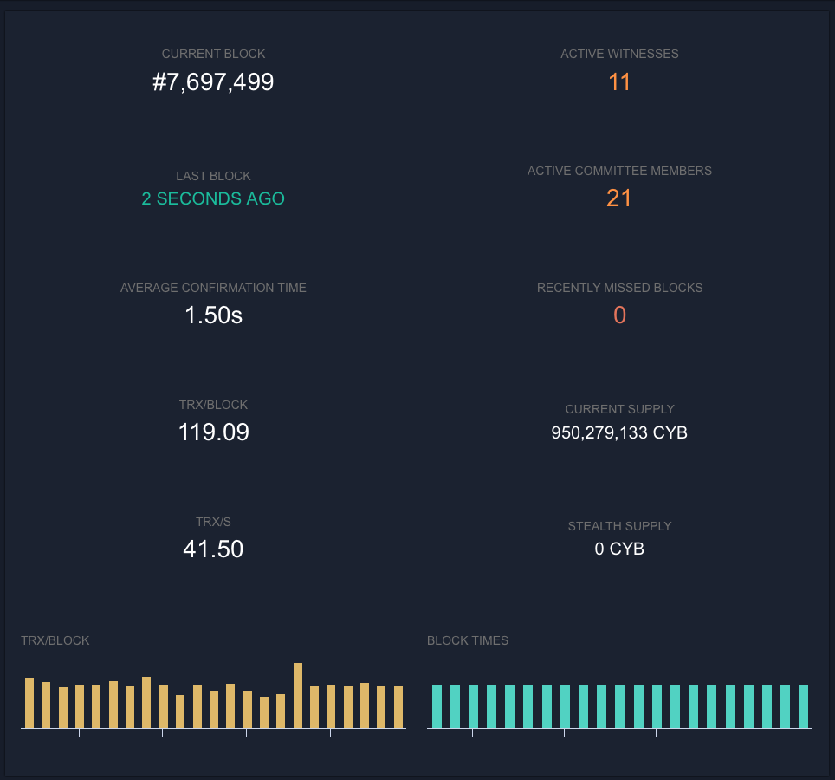
Value Package – Witness Node
Decentralized Financial Infrastructure Solution
“
Software portfolio
The witness node owner can entrust the operation and maintenance to Cybex afterwards, the owner earns the returns which are paid by the Cybex network as a block producer.
Cybex witness node code
IF YOU HAVE HARDWARE EQUIPMENTS AND WANT TO RUN A WITNESS NODE.
Cost of partner
Hardware equipment
Income of partner
Witness node shares

Slide 12
Annual Revenue Estimation – Witness Node
Decentralized Financial Infrastructure Solution
 | Items | Description
INCOME | Witness Node Shares | Mining as a Cybex witness node | US$ 15,000.00
COST | Hardware Equipment | (Alibaba Cloud or AWS) CPU: 4 core Memory: 32G Hard disk: 500G or above | US$ 5,000.00
NET INCOME |  |  | US$ 10,000.00
* Marketing and operation fees are not included in the estimation.

Slide 13
Value Package – Cybex Gateway
Decentralized Financial Infrastructure Solution
For the partners who have their own commercial applications, Cybex’s benefits can help them to earn a profit by providing a valuable service to the Cybex community.
“
IF YOU WISH TO BECOME A CYBEX GATEWAY TO PROVIDE THE SERVICE OF BRIDGING EXTERNAL ASSETS INTO THE CYBEX NETWORK.
Software portfolio includes:
Cybex gateway and gateway management system.
(Optional) Jadepool and Jadepool management system.
(Optional) Wookong enterprise version.
Cost of business partner：
”
Hardware equipment
Development and online maintenance team
Marketing and operation fee
Income of business partner：
Cybex gateway fees
Cybex transaction fee shares
The gateway fee and transaction fee shares are positively correlated with the funds into and out of Cybex from your gateway and exchange activity in DEX.

Slide 14
Annual Revenue Estimation – Cybex Gateway
Decentralized Financial Infrastructure Solution
 | Items | Description
INCOME | Exchange Fee Shares | Exchange will charge customers for transaction fees. As a gateway, fees are shared according to the source of customers. | US$ 100,000.00
 | Gateway Service Fees | Service fees as Cybex gateway | US$ 30,000.00
COST | Hardware Equipment | (Alibaba Cloud or AWS) CPU: 4 core Memory: 32G Hard disk: 500G or above | US$ 5,000.00
 | Research & Development Team | System and DAPPs development Online Maintenance | US$ 50,000.00
NET INCOME |  |  | US$ 75,000.00
* Marketing and operation fees are not included in the estimation.

Slide 15

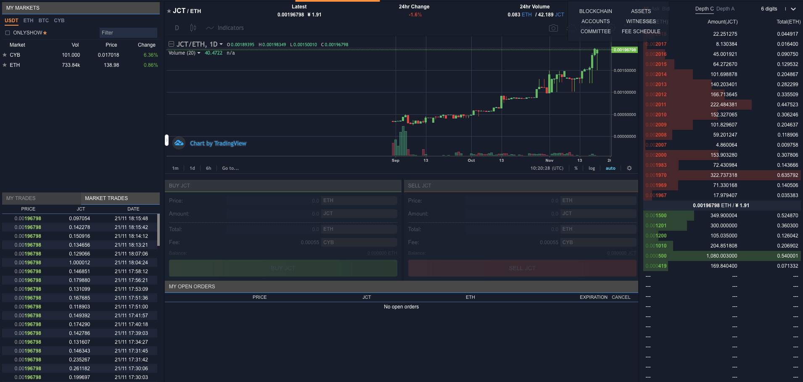
Value Package – White Label Exchange
Decentralized Financial Infrastructure Solution
Cybex provides a complete solution which helps our partner focus on market development and customer service.
IF YOU HAVE MARKETING RESOURCES AND PLAN TO RUN AN EXCHANGE BY YOURSELF.
Software portfolio includes:
DEX website, iOS and Android apps.
Cybex gateway and gateway management system.
Cybex witness node code.
Jadepool and Jadepool management system.
Wookong enterprise version.
Cost of business partner：
Hardware equipment
Development and online maintenance team
Marketing and operation fee
Income of business partner：
Witness node shares
Cybex gateway fees
Cybex transaction fee shares
The gateway fee and transaction fee shares are positively correlated with your user volume and exchange activity.

Slide 16
Annual Revenue Estimation – White Label Exchange
Decentralized Financial Infrastructure Solution
 | Items | Description
INCOME | Witness Node Shares | Mining as a Cybex witness node | US$ 15,000.00
 | Exchange Fee Shares | Exchange will charge customers for transaction fees. As a gateway, fees are shared according to the source of customers. | US$ 200,000.00
 | Gateway Service Fees | Service fees as Cybex gateway | US$ 30,000.00
COST | Hardware Equipment | (Alibaba Cloud or AWS) CPU: 4 core Memory: 32G Hard disk: 500G or above | US$ 5,000.00
 | Research & Development Team | DAPP & system development Online Maintenance | US$ 50,000.00
NET INCOME |  |  | US$ 190,000.00
* Marketing and operation fees are not included in the estimation.

Slide 17
04
Partner with Cybex
As a business partner, you become part of the Cybex ecosystem designed to help you achieve new levels of success.

Slide 18


Partner with Cybex
Decentralized Financial Infrastructure Solution
All business partners are eligible to access the software catalog of Cybex for demonstration, evaluation, development and testing of commercial solutions by a certain amount of CYB as collateral.
Integration
& Testing
Online Maintenance
Round out Portfolio
Training & Deployment
Solution Consultant
Sign Agreement

Slide 19
Learn More About Cybex
Decentralized Financial Infrastructure Solution
Cybex Official Website www.cybex.io
Cybex Decentralized Exchange dex.cybex.io
Cybex Developers Wiki github.com/CybexDex/cybex-node-doc/wiki
Jadepool Brochure www.nbltrust.com/jadepool_brochure_en.pdf
Wookong Official Website wookong.nbltrust.com/

Slide 20
THANK YOU FOR YOUR COOPERATION
Decentralized Financial Infrastructure Solution
Cybex Confidential Proprietary

